Slide 1
UNIT 2
Life cycle phases
Dr. K.Jayasri

Slide 2
Life Cycle phases
The characteristic of a successful software development process is the well-defined separation between "research and development" activities and "production" activities. Most unsuccessful projects exhibit one of the following characteristics:
An overemphasis on research and development
An overemphasis on production.

Slide 3
Life Cycle phases
Successful modern projects-and even successful projects developed under the conventional process-tend to have a very well-defined project milestone when there is a noticeable transition from a research attitude to a production attitude.
Earlier phases focus on achieving functionality. Later phases revolve around achieving a product that can be shipped to a customer, with explicit attention to robustness, performance, and finish. modern software development process must be defined to support the following:
Evolution of the plans, requirements, and architecture, together with well defined synchronization points
Risk management and objective measures of progress and quality
Evolution of system capabilities through demonstrations of increasing functionality

Slide 4
Life Cycle phases ENGINEERING AND PRODUCTION STAGES
To achieve economies of scale and higher returns on investment, we must move toward a software manufacturing process driven by technological improvements in process automation and component-based development. Two stages of the life cycle are:
The engineering stage, driven by less predictable but smaller teams doing design and synthesis activities
The production stage, driven by more predictable but larger teams doing construction, test, and deployment activities

Slide 5
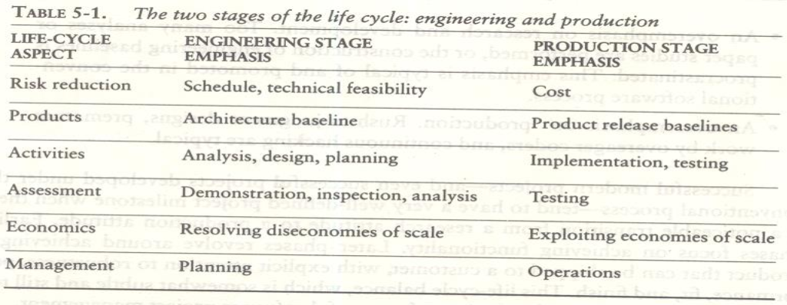
Life Cycle phases ENGINEERING AND PRODUCTION STAGES

Slide 6
Life Cycle phases ENGINEERING AND PRODUCTION STAGES
The transition between engineering and production is a crucial event for the various stakeholders.
The production plan has been agreed upon, and there is a good enough understanding of the problem and the solution that all stakeholders can make a firm commitment to go ahead with production.
Engineering stage is decomposed into two distinct phases, inception and elaboration, and the production stage into construction and transition.
These four phases of the life-cycle process are loosely mapped to the conceptual framework of the spiral model

Slide 7
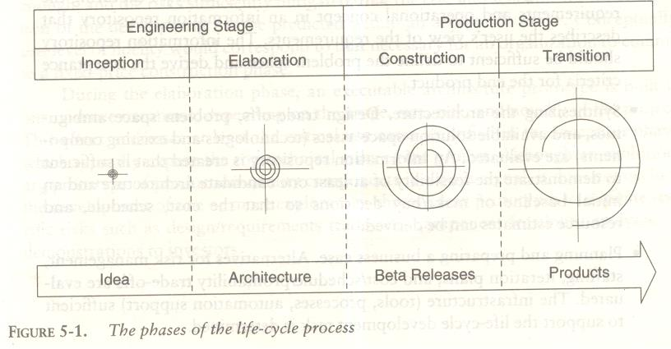
Life Cycle phases ENGINEERING AND PRODUCTION STAGES

Slide 8
Life Cycle phases INCEPTION PHASE
The overriding goal of the inception phase is to achieve concurrence among stakeholders on the life-cycle objectives for the project.
PRIMARY OBJECTIVES
Establishing the project's software scope and boundary conditions, including an operational concept, acceptance criteria, and a clear understanding of what is and is not intended to be in the product
Discriminating the critical use cases of the system and the primary scenarios of operation that will drive the major design trade-offs
Demonstrating at least one candidate architecture against some of the primary scenarios
Estimating the cost and schedule for the entire project (including detailed estimates for the elaboration phase)
Estimating potential risks (sources of unpredictability)

Slide 9
Life Cycle phases INCEPTION PHASE
ESSENTIAL ACTIVITIES
Formulating the scope of the project. The information repository should be sufficient to define the problem space and derive the acceptance criteria for the end product.
Synthesizing the architecture. An information repository is created that is sufficient to demonstrate the feasibility of at least one candidate architecture and an initial baseline of make/buy decisions so that the cost, schedule, and resource estimates can be derived.
Planning and preparing a business case. Alternatives for risk management, staffing, iteration plans, and cost/schedule/ profitability trade-offs are evaluated.

Slide 10
Life Cycle phases INCEPTION PHASE
PRIMARY EVALUATION CRITERIA
Do all stakeholders concur on the scope definition and cost and schedule estimates?
Are requirements understood, as evidenced by the fidelity of the critical use cases?
Are the cost and schedule estimates, priorities, risks, and development processes credible?
Do the depth and breadth of an architecture prototype demonstrate the preceding criteria? (The primary value of prototyping candidate architecture is to provide a vehicle for understanding the scope and assessing the credibility of the development group in solving the particular technical problem.)
Are actual resource expenditures versus planned expenditures acceptable

Slide 11
Life Cycle phases ELABORATION PHASE
At the end of this phase, the "engineering" is considered complete. The elaboration phase activities must ensure that the architecture, requirements, and plans are stable enough, and the risks sufficiently mitigated, that the cost and schedule for the completion of the development can be predicted within an acceptable range.
During the elaboration phase, an executable architecture prototype is built in one or more iterations, depending on the scope, size, & risk.
PRIMARY OBJECTIVES
Baselining the architecture as rapidly as practical (establishing a configuration-managed snapshot in which all changes are rationalized, tracked, and maintained)
Baselining the vision
Baselining a high-fidelity plan for the construction phase
Demonstrating that the baseline architecture will support the vision at a reasonable cost in a reasonable time

Slide 12
Life Cycle phases ELABORATION PHASE
ESSENTIAL ACTIVITIES
Elaborating the vision.
Elaborating the process and infrastructure.
Elaborating the architecture and selecting components.
PRIMARY EVALUATION CRITERIA
Is the vision stable?
Is the architecture stable?
Does the executable demonstration show that the major risk elements have been addressed and credibly resolved?
Is the construction phase plan of sufficient fidelity, and is it backed up with a credible basis of estimate?
Do all stakeholders agree that the current vision can be met if the current plan is executed to develop the complete system in the context of the current architecture?
Are actual resource expenditures versus planned expenditures acceptable?

Slide 13
Life Cycle phases CONSTRUCTION PHASE
During the construction phase, all remaining components and application features are integrated into the application, and all features are thoroughly tested.
Newly developed software is integrated where required. The construction phase represents a production process, in which emphasis is placed on managing resources and controlling operations to optimize costs, schedules, and quality.
PRIMARY OBJECTIVES
Minimizing development costs by optimizing resources and avoiding unnecessary scrap and rework
Achieving adequate quality as rapidly as practical
Achieving useful versions (alpha, beta, and other test releases) as rapidly as practical

Slide 14
Life Cycle phases CONSTRUCTION PHASE
ESSENTIAL ACTIVITIES
Resource management, control, and process optimization
Complete component development and testing against evaluation criteria
Assessment of product releases against acceptance criteria of the vision
PRIMARY EVALUATION CRITERIA
Is this product baseline mature enough to be deployed in the user community? (Existing defects are not obstacles to achieving the purpose of the next release.)
Is this product baseline stable enough to be deployed in the user community? (Pending changes are not obstacles to achieving the purpose of the next release.)
Are the stakeholders ready for transition to the user community?
Are actual resource expenditures versus planned expenditures acceptable?

Slide 15
Life Cycle phases TRANSITION PHASE
The transition phase is entered when a baseline is mature enough to be deployed in the end-user domain. This typically requires that a usable subset of the system has been achieved with acceptable quality levels and user documentation so that transition to the user will provide positive results. This phase could include any of the following activities:
Beta testing to validate the new system against user expectations
Beta testing and parallel operation relative to a legacy system it is replacing
Conversion of operational databases
Training of users and maintainers
The transition phase concludes when the deployment baseline has achieved the complete vision.

Slide 16
Life Cycle phases TRANSITION PHASE
PRIMARY OBJECTIVES
Achieving user self-supportability
Achieving stakeholder concurrence that deployment baselines are complete and consistent with the evaluation criteria of the vision
Achieving final product baselines as rapidly and cost-effectively as practical
E SSENTIAL ACTIVITIES
Synchronization and integration of concurrent construction increments into consistent deployment baselines
Deployment-specific engineering (cutover, commercial packaging and production, sales rollout kit development, field personnel training)
Assessment of deployment baselines against the complete vision and acceptance criteria in the requirements set
VALUATION CRITERIA
Is the user satisfied?
Are actual resource expenditures versus planned expenditures acceptable?

Slide 17
Artifacts of the process
THE ARTIFACT SETS
To make the development of a complete software system manageable, distinct collections of information are organized into artifact sets. Artifact represents cohesive information that typically is developed and reviewed as a single entity.
Life-cycle software artifacts are organized into five distinct sets that are roughly partitioned by the underlying language of the set: management (ad hoc textual formats), requirements (organized text and models of the problem space), design (models of the solution space), implementation (human-readable programming language and associated source files), and deployment (machine-process able languages and associated files).

Slide 18
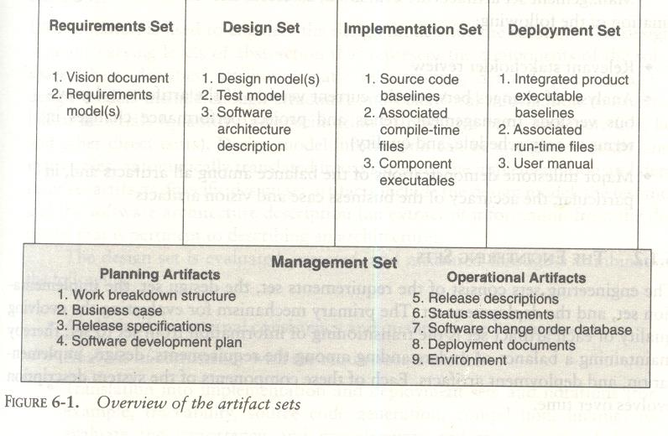
THE ARTIFACT SETS

Slide 19
THE MANAGEMENT SET
The management set captures the artifacts associated with process planning and execution.
These artifacts use ad hoc notations, including text, graphics, or whatever representation is required to capture the "contracts" among project personnel (project management, architects, developers, testers, marketers, administrators), among stakeholders (funding authority, user, software project manager, organization manager, regulatory agency), and between project personnel and stakeholders.

Slide 20
THE MANAGEMENT SET
Specific artifacts included in this set are the
work breakdown structure (activity breakdown and financial tracking mechanism),
the business case (cost, schedule, profit expectations),
the release specifications (scope, plan, objectives for release baselines),
the software development plan (project process instance),
the release descriptions (results of release baselines), the status assessments (periodic snapshots of project progress),
the software change orders (descriptions of discrete baseline changes),
the deployment documents (cutover plan, training course, sales rollout kit), and
the environment (hardware and software tools, process automation &documentation).

Slide 21
THE MANAGEMENT SET
Management set artifacts are evaluated, assessed, and measured through a combination of the following:
Relevant stakeholder review
Analysis of changes between the current version of the artifact and previous versions
Major milestone demonstrations of the balance among all artifacts and, in particular, the accuracy of the business case and vision artifacts

Slide 22
THE ENGINEERING SETS
The engineering sets consist of the requirements set, the design set, the
implementation set, and the deployment set.
Requirements Set
Requirements artifacts are evaluated, assessed, and measured through
a combination of the following:
Analysis of consistency with the release specifications of the management set
Analysis of consistency between the vision and the requirements model
Mapping against the design, implementation, and deployment sets to evaluate the consistency and completeness and the semantic balance between information in the different sets
Analysis of changes between the current version of requirements artifacts and previous versions (scrap, rework, and defect elimination trends.
Subjective review of other dimensions of quality

Slide 23
THE ENGINEERING SETS
Design Set
UML notation is used to engineer the design models for the solution. The design set contains varying levels of abstraction that represent the components of the solution space (their identities, attributes, static relationships, dynamic interactions). The design set is evaluated, assessed, and measured through a combination of the following:
Analysis of the internal consistency and quality of the design model
Analysis of consistency with the requirements models
Translation into implementation and deployment sets and notations (for example, traceability, source code generation, compilation, linking) to evaluate the consistency and completeness and the semantic balance between information in the sets
Analysis of changes between the current version of the design model and previous versions (scrap, rework, and defect elimination trends)
Subjective review of other dimensions of quality

Slide 24
THE ENGINEERING SETS
Implementation set
The implementation set includes source code (programming language notations) that represents the tangible implementations of components (their form, interface, and dependency relationships) Implementation sets are human-readable formats that are evaluated, assessed, and measured through a combination of the following:
Analysis of consistency with the design models
Translation into deployment set notations (for example, compilation and linking) to evaluate the consistency and completeness among artifact sets
Assessment of component source or executable files against relevant evaluation criteria through inspection, analysis, demonstration, or testing
Execution of stand-alone component test cases that automatically compare expected results with actual results
Analysis of changes between the current version of the implementation set and previous versions (scrap, rework, and defect elimination trends)
Subjective review of other dimensions of quality

Slide 25
THE ENGINEERING SETS
Deployment Set
The deployment set includes user deliverables and machine language notations, executable software, and the build scripts, installation scripts, and executable target specific data necessary to use the product in its target environment. Deployment sets are evaluated, assessed, and measured through a combination of the following:
Testing against the usage scenarios and quality attributes defined in the requirements set to evaluate the consistency and completeness and the semantic balance between information in the two sets
Testing the partitioning, replication, and allocation strategies in mapping components of the implementation set to physical resources of the deployment system (platform type, number, network topology)
Testing against the defined usage scenarios in the user manual such as installation, user-oriented dynamic reconfiguration, mainstream usage, and anomaly management
Analysis of changes between the current version of the deployment set and previous versions (defect elimination trends, performance changes)
Subjective review of other dimensions of quality

Slide 26
THE ENGINEERING SETS
Most of today's software development tools map closely to one of the five artifact sets.
Management: scheduling, workflow, defect tracking, change management, documentation, spreadsheet, resource management, and presentation tools
Requirements: requirements management tools
Design: visual modeling tools
Implementation: compiler/debugger tools, code analysis tools, test coverage analysis tools, and test management tools
Deployment: test coverage and test automation tools, network management tools, commercial components (operating systems, GUIs, RDBMS, networks, middleware), and installation tools.

Slide 27
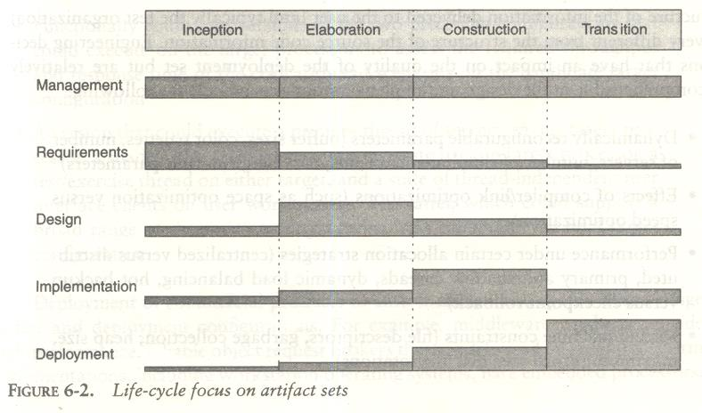
THE ENGINEERING SETS

Slide 28
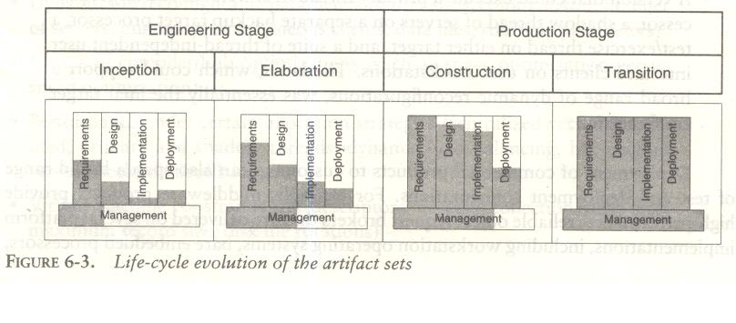
ARTIFACT EVOLUTION OVER THE LIFE CYCLE

Slide 29
TEST ARTIFACTS
The test artifacts must be developed concurrently with the product from inception through deployment. Thus, testing is a full-life-cycle activity, not a late life-cycle activity.
The test artifacts are communicated, engineered, and developed within the same artifact sets as the developed product.
The test artifacts are implemented in programmable and repeatable formats (as software programs).
The test artifacts are documented in the same way that the product is documented.
Developers of the test artifacts use the same tools, techniques, and training as the software engineers developing the product.

Slide 30
TEST ARTIFACTS
Test artifact subsets are highly project-specific, the following example clarifies the relationship between test artifacts and the other artifact sets. Consider a project to perform seismic data processing for the purpose of oil exploration.
This system has three fundamental subsystems:
a sensor subsystem that captures raw seismic data in real time and delivers these data to
a technical operations subsystem that converts raw data into an organized database and manages queries to this database from
a display subsystem that allows workstation operators to examine seismic data in human-readable form.
Such a system would result in the following test artifacts:

Slide 31
TEST ARTIFACTS
Test artifact subsets are highly project-specific, the following example clarifies the relationship between test artifacts and the other artifact sets. Consider a project to perform seismic data processing for the purpose of oil exploration.
This system has three fundamental subsystems:
a sensor subsystem that captures raw seismic data in real time and delivers these data to
a technical operations subsystem that converts raw data into an organized database and manages queries to this database from
a display subsystem that allows workstation operators to examine seismic data in human-readable form.
Such a system would result in the following test artifacts:

Slide 32
TEST ARTIFACTS
Management set.
The release specifications and release descriptions capture the objectives, evaluation criteria, and results of an intermediate milestone.
These artifacts are the test plans and test results negotiated among internal project teams.
The software change orders capture test results (defects, testability changes, requirements ambiguities, enhancements) and the closure criteria associated with making a discrete change to a baseline.
Requirements set.
The system-level use cases capture the operational concept for the system and the acceptance test case descriptions, including the expected behavior of the system and its quality attributes.
The entire requirement set is a test artifact because it is the basis of all assessment activities across the life cycle.

Slide 33
TEST ARTIFACTS
Design set.
A test model for non deliverable components needed to test the product baselines is captured in the design set.
These components include such design set artifacts as a seismic event simulation for creating realistic sensor data; a "virtual operator" that can support unattended, afterhours test cases; specific instrumentation suites for early demonstration of resource usage; transaction rates or response times; and use case test drivers and component stand-alone test drivers.
Implementation set.
Self-documenting source code representations for test components and test drivers provide the equivalent of test procedures and test scripts.
These source files may also include human-readable data files representing certain statically defined data sets that are explicit test source files.
Output files from test drivers provide the equivalent of test reports.
Deployment set.
versions of test components, test drivers, and data files are provided.

Slide 34
PRAGMATIC ARTIFACTS
People want to review information but don't understand the language of the artifact.
Many interested reviewers of a particular artifact will resist having to learn the engineering language in which the artifact is written.
It is not uncommon to find people (such as veteran software managers, veteran quality assurance specialists, or an auditing authority from a regulatory agency) who react as follows:
"I'm not going to learn UML, but I want to review the design of this software, so give me a separate description such as some flowcharts and text that I can understand.

Slide 35
PRAGMATIC ARTIFACTS
People want to review the information but don't have access
to the tools.
It is not very common for the development organization to be fully tooled; it is extremely rare that the/other stakeholders have any capability to review the engineering artifacts on-line. Consequently, organizations are forced to exchange paper documents.
Standardized formats (such as UML, spreadsheets, Visual Basic, C++, and Ada 95), visualization tools, and the Web are rapidly making it economically feasible for all stakeholders to exchange information electronically.

Slide 36
PRAGMATIC ARTIFACTS
Human-readable engineering artifacts should use rigorous notations that
are complete, consistent, and used in a self-documenting manner.
Properly spelled English words should be used for all identifiers and descriptions.
Acronyms and abbreviations should be used only where they are well accepted jargon in the context of the component's usage.
Readability should be emphasized and the use of proper English words should be required in all engineering artifacts.
This practice enables understandable representations, browse able formats (paperless review), more-rigorous notations, and reduced error rates.
Useful documentation is self-defining: It is documentation that gets used.
Paper is tangible; electronic artifacts are too easy to change.
On-line and Web-based artifacts can be changed easily and are viewed with more skepticism because of their inherent volatility.

Slide 37
MANAGEMENT ARTIFACTS
Business Case
The business case artifact provides all the information necessary to determine whether the project is worth investing in.
It details the expected revenue, expected cost, technical and management plans, and backup data necessary to demonstrate the risks and realism of the plans.
The main purpose is to transform the vision into economic terms so that an organization can make an accurate ROI assessment.
The financial forecasts are evolutionary, updated with more accurate forecasts as the life cycle progresses.

Slide 38
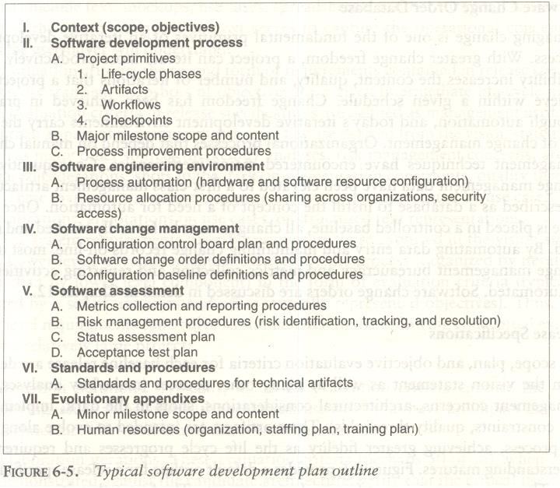
MANAGEMENT ARTIFACTS

Slide 39
MANAGEMENT ARTIFACTS
Work Breakdown Structure
Work breakdown structure (WBS) is the vehicle for budgeting and collecting costs.
To monitor and control a project's financial performance, the software project manager must have insight into project costs and how they are expended.
The structure of cost accountability is a serious project planning constraint.
Software Change Order Database
Managing change is one of the fundamental primitives of an iterative development process.
With greater change freedom, a project can iterate more productively. This flexibility increases the content, quality, and number of iterations that a project can achieve within a given schedule.
Change freedom has been achieved in practice through automation, and today's iterative development environments carry the burden of change management.
Organizational processes that depend on manual change management techniques have encountered major inefficiencies.

Slide 40
MANAGEMENT ARTIFACTS
Release Specifications
The scope, plan, and objective evaluation criteria for each baseline release are derived from the vision statement as well as many other sources (make/buy analyses, risk management concerns, architectural considerations, shots in the dark, implementation constraints, quality thresholds).
These artifacts are intended to evolve along with the process, achieving greater fidelity as the life cycle progresses and requirements understanding matures.

Slide 41
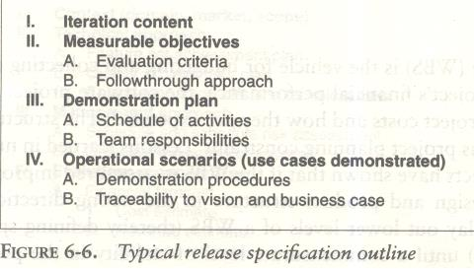
MANAGEMENT ARTIFACTS

Slide 42
MANAGEMENT ARTIFACTS
Release Descriptions
Release description documents describe the results of each release, including performance against each of the evaluation criteria in the corresponding release specification.
Release baselines should be accompanied by a release description document that describes the evaluation criteria for that configuration baseline and provides substantiation (through demonstration, testing, inspection, or analysis) that each criterion has been addressed in an acceptable manner
Status Assessments
Status assessments provide periodic snapshots of project health and status, including the software project manager's risk assessment, quality indicators, and management indicators.
Typical status assessments should include a review of resources, personnel staffing, financial data (cost and revenue), top 10 risks, technical progress (metrics snapshots), major milestone plans and results, total project or product scope & action items

Slide 43
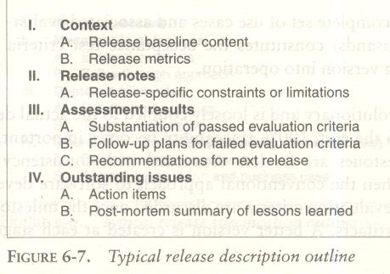
MANAGEMENT ARTIFACTS

Slide 44
MANAGEMENT ARTIFACTS
Environment
An important emphasis of a modern approach is to define the development and maintenance environment as a first-class artifact of the process.
A robust, integrated development environment must support automation of the development process.
This environment should include requirements management, visual modeling, document automation, host and target programming tools, automated regression testing, and continuous and integrated change management, and feature and defect tracking.
Deployment
A deployment document can take many forms. Depending on the project, it could include several document subsets for transitioning the product into operational status.
In big contractual efforts in which the system is delivered to a separate maintenance organization, deployment artifacts may include computer system operations manuals, software installation manuals, plans and procedures for cutover (from a legacy system), site surveys, and so forth. For commercial software products, deployment artifacts may include marketing plans, sales rollout kits, and training courses.
Management Artifact Sequences
In each phase of the life cycle, new artifacts are produced and previously developed artifacts are updated to incorporate lessons learned and to capture further depth and breadth of the solution

Slide 45
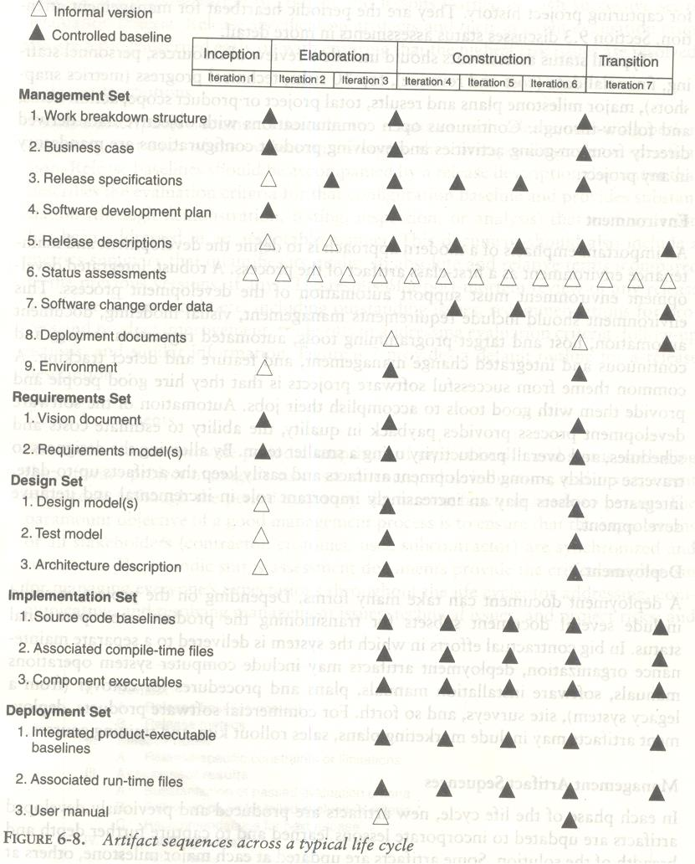
MANAGEMENT ARTIFACTS

Slide 46
ENGINEERING ARTIFACTS
Most of the engineering artifacts are captured in rigorous engineering notations such as UML, programming languages, or executable machine codes.
Three engineering artifacts are explicitly intended for more general review, and they deserve further elaboration.
Vision Document
The vision document provides a complete vision for the software system under development and. supports the contract between the funding authority and the development organization.
A project vision is meant to be changeable as understanding evolves of the requirements, architecture, plans, and technology.
A good vision document should change slowly.

Slide 47
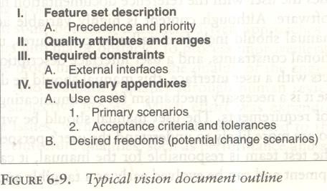
ENGINEERING ARTIFACTS

Slide 48
ENGINEERING ARTIFACTS
Architecture Description
The architecture description provides an organized view of the software architecture under development.
It is extracted largely from the design model and includes views of the design, implementation, and deployment sets sufficient to understand how the operational concept of the requirements set will be achieved.
The breadth of the architecture description will vary from project to project depending on many factors.
Software User Manual
The software user manual provides the user with the reference documentation necessary to support the delivered software.
Although content is highly variable across application domains, the user manual should include installation procedures, usage procedures and guidance, operational constraints, and a user interface description, at a minimum.
For software products with a user interface, this manual should be developed early in the life cycle because it is a necessary mechanism for communicating and stabilizing an important subset of requirements.
The user manual should be written by members of the test team, who are more likely to understand the user's perspective than the development team.

Slide 49
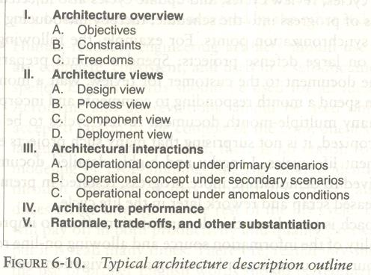
ENGINEERING ARTIFACTS

Slide 50
ARCHITECTURE: A MANAGEMENT PERSPECTIVE
The most critical technical product of a software project is its architecture: the infrastructure, control, and data interfaces that permit software components to cooperate as a system and software designers to cooperate efficiently as a team.
When the communications media include multiple languages and intergroup literacy varies, the communications problem can become extremely complex and even unsolvable.
If a software development team is to be successful, the inter project communications, as captured in the software architecture, must be both accurate and precise

Slide 51
ARCHITECTURE: A MANAGEMENT PERSPECTIVE
From a management perspective, there are three different aspects of
architecture.
An architecture (the intangible design concept) is the design of a software system this includes all engineering necessary to specify a complete bill of materials.
An architecture baseline (the tangible artifacts) is a slice of information across the engineering artifact sets sufficient to satisfy all stakeholders that the vision (function and quality) can be achieved within the parameters of the business case (cost, profit, time, technology, and people).
An architecture description (a human-readable representation of an architecture, which is one of the components of an architecture baseline) is an organized subset of information extracted from the design set model(s). The architecture description communicates how the intangible concept is realized in the tangible artifacts.

Slide 52
ARCHITECTURE: A MANAGEMENT PERSPECTIVE
The importance of software architecture and its close linkage with modern software development processes can be summarized as follows:
Achieving a stable software architecture represents a significant project milestone at which the critical make/buy decisions should have been resolved.
Architecture representations provide a basis for balancing the trade-offs between the problem space (requirements and constraints) and the solution space (the operational product).
The architecture and process encapsulate many of the important (high-payoff or high-risk) communications among individuals, teams, organizations, and stakeholders.

Slide 53
ARCHITECTURE: A MANAGEMENT PERSPECTIVE
4. Poor architectures and immature processes are often given as reasons for project failures.
A mature process, an understanding of the primary
requirements, and a demonstrable architecture are important prerequisites for predictable planning.
6. Architecture development and process definition are the intellectual steps that map the problem to a solution without violating the constraints; they require human innovation and cannot be automated.

Slide 54
ARCHITECTURE: A TECHNICAL PERSPECTIVE
An architecture framework is defined in terms of views that are abstractions of the UML models in the design set. The design model includes the full breadth and depth of information. An architecture view is an abstraction of the design model; it contains only the architecturally significant information. Most real-world systems require four views: design, process, component, and deployment. The purposes of these views are as follows:
Design: describes architecturally significant structures and functions of the design model
Process: describes concurrency and control thread relationships among the design, component, and deployment views
Component: describes the structure of the implementation set
Deployment: describes the structure of the deployment set

Slide 55
ARCHITECTURE: A TECHNICAL PERSPECTIVE
The requirements model addresses the behavior of the system as seen by its end users, analysts, and testers. This view is modeled statically using use case and class diagrams, and dynamically using sequence, collaboration, state chart, and activity diagrams.
The use case view describes how the system's critical (architecturally significant) use cases are realized by elements of the design model. It is modeled statically using use case diagrams, and dynamically using any of the UML behavioral diagrams.
The design view describes the architecturally significant elements of the design model. This view, an abstraction of the design model, addresses the basic structure and functionality of the solution. It is modeled statically using class and object diagrams, and dynamically using any of the UML behavioral diagrams.

Slide 56
ARCHITECTURE: A TECHNICAL PERSPECTIVE
The process view addresses the run-time collaboration issues involved in executing the architecture on a distributed deployment model, including the logical software network topology (allocation to processes and threads of control), interprocess communication, and state management. This view is modeled statically using deployment diagrams, and dynamically using any of the UML behavioral diagrams.
The component view describes the architecturally significant elements of the implementation set. This view, an abstraction of the design model, addresses the software source code realization of the system from the perspective of the project's integrators and developers, especially with regard to releases and configuration management. It is modeled statically using component diagrams, and dynamically using any of the UML behavioral diagrams.
The deployment view addresses the executable realization of the system, including the allocation of logical processes in the distribution view (the logical software topology) to physical resources of the deployment network (the physical system topology). It is modeled statically using deployment diagrams, and dynamically using any of the UML behavioral diagrams.

Slide 57
ARCHITECTURE: A TECHNICAL PERSPECTIVE
Generally, an architecture baseline should include the following:
Requirements: critical use cases, system-level quality objectives, and priority relationships among features and qualities
Design: names, attributes, structures, behaviors, groupings, and relationships of significant classes and components
Implementation: source component inventory and bill of materials (number, name, purpose, cost) of all primitive components
Deployment: executable components sufficient to demonstrate the critical use cases and the risk associated with achieving the system qualities

Slide 58
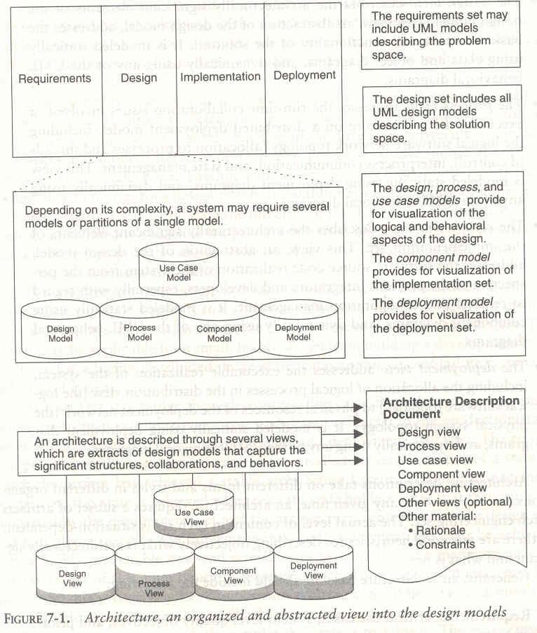
ARCHITECTURE: A TECHNICAL PERSPECTIVE

Slide 59
SOFTWARE PROCESS WORKFLOWS
The term WORKFLOWS is used to mean a thread of cohesive and mostly sequential activities. Workflows are mapped to product artifacts There are seven top-level workflows:
Management workflow: controlling the process and ensuring win conditions for all stakeholders
Environment workflow: automating the process and evolving the maintenance environment
Requirements workflow: analyzing the problem space and evolving the requirements artifacts
Design workflow: modeling the solution and evolving the architecture and design artifacts
Implementation workflow: programming the components and evolving the implementation and deployment artifacts
Assessment workflow: assessing the trends in process and product quality
Deployment workflow: transitioning the end products to the user

Slide 60
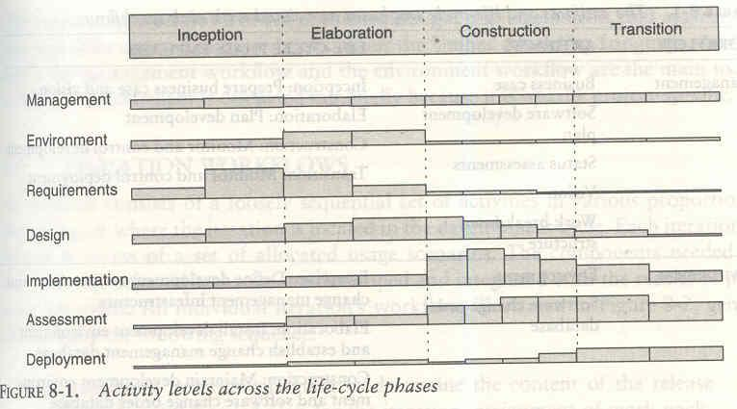
SOFTWARE PROCESS WORKFLOWS

Slide 61
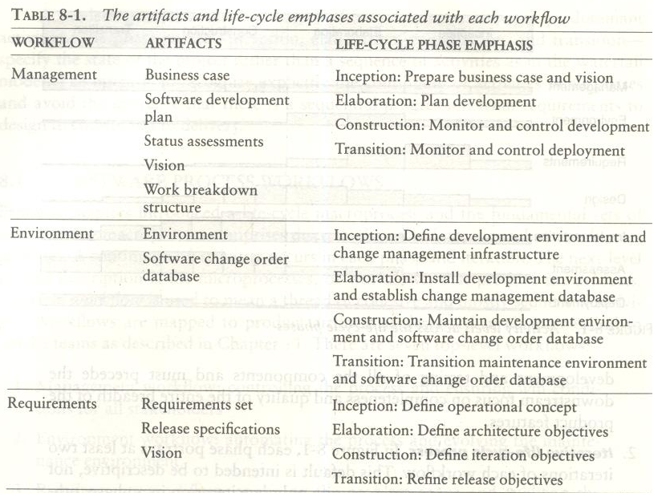
SOFTWARE PROCESS WORKFLOWS

Slide 62
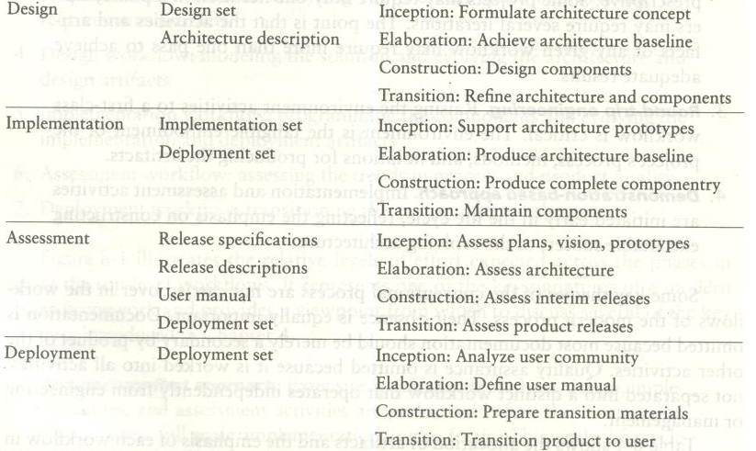
SOFTWARE PROCESS WORKFLOWS

Slide 63
ITERATION WORKFLOWS
Iteration consists of a loosely sequential set of activities in various proportions, depending on where the iteration is located in the development cycle. Each iteration is defined in terms of a set of allocated usage scenarios. An individual iteration's workflow, generally includes the following sequence:
Management: iteration planning to determine the content of the release and develop the detailed plan for the iteration; assignment of work packages, or tasks, to the development team
Environment: evolving the software change order database to reflect all new baselines and changes to existing baselines for all product, test, and environment components

Slide 64
ITERATION WORKFLOWS
Requirements: analyzing the baseline plan, the baseline architecture, and the baseline requirements set artifacts to fully elaborate the use cases to be demonstrated at the end of this iteration and their evaluation criteria; updating any requirements set artifacts to reflect changes necessitated by results of this iteration's engineering activities
Design: evolving the baseline architecture and the baseline design set artifacts to elaborate fully the design model and test model components necessary to demonstrate against the evaluation criteria allocated to this iteration; updating design set artifacts to reflect changes necessitated by the results of this iteration's engineering activities
Implementation: developing or acquiring any new components, and enhancing or modifying any existing components, to demonstrate the evaluation criteria allocated to this iteration; integrating and testing all new and modified components with existing baselines (previous versions)

Slide 65
ITERATION WORKFLOWS
Assessment: evaluating the results of the iteration, including compliance with the allocated evaluation criteria and the quality of the current baselines; identifying any rework required and determining whether it should be performed before deployment of this release or allocated to the next release; assessing results to improve the basis of the subsequent iteration's plan.
Deployment: transitioning the release either to an external organization (such as a user, independent verification and validation contractor, or regulatory agency) or to internal closure by conducting a post-mortem so that lessons learned can be captured and reflected in the next iteration

Slide 66
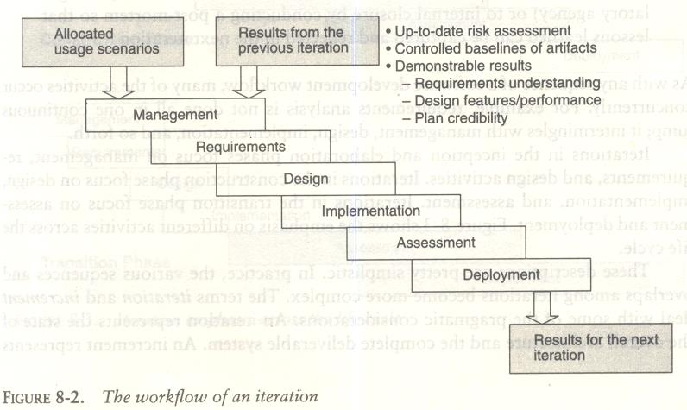
ITERATION WORKFLOWS

Slide 67
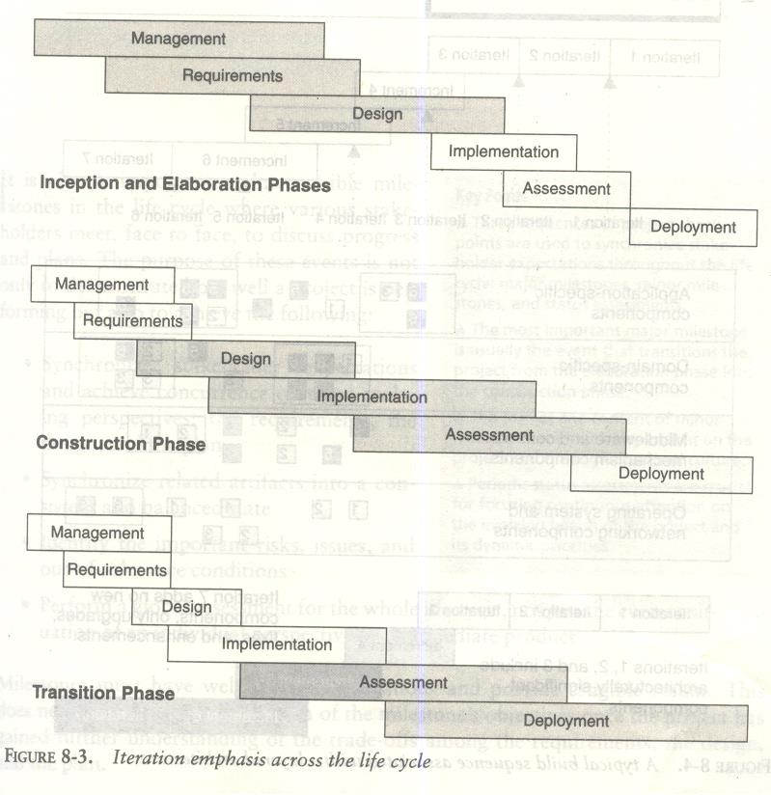
ITERATION WORKFLOWS

Slide 68
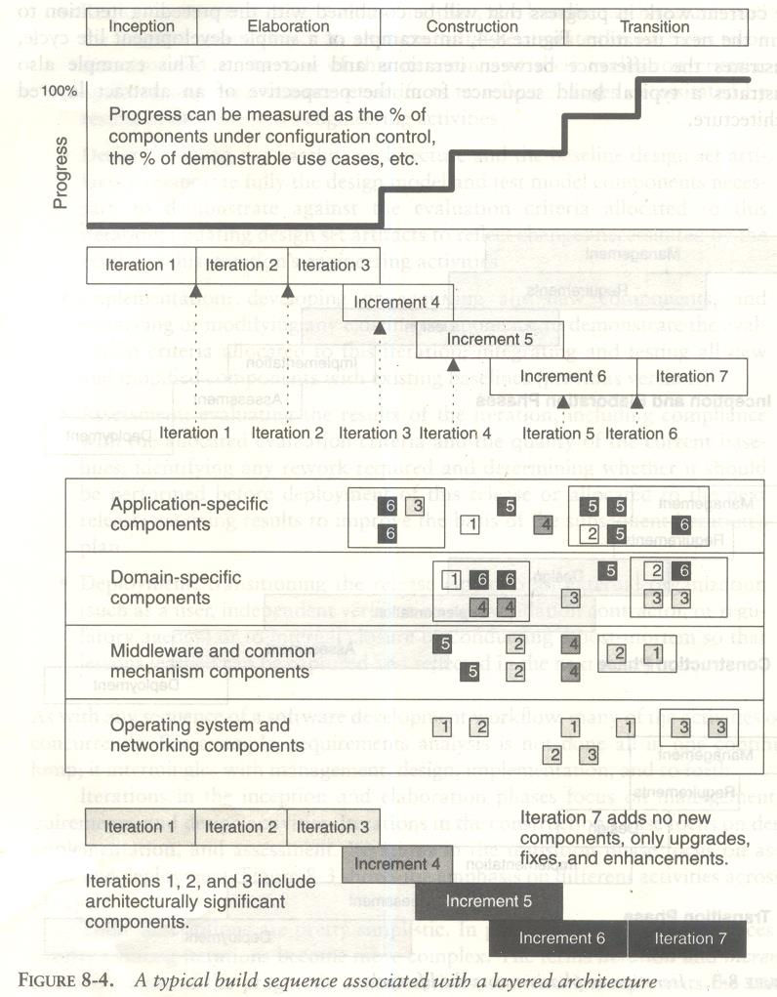
ITERATION WORKFLOWS

Slide 69
THANK YOU

